Slide 1

Data Science Challenge Tamanna
André Oliveira

Slide 2
gOALs
Determine the quality of the data (missing value, mixed value type in a column and so on)
Are there any relationships between the features?
Figure out 3 possible uses cases that can be used to derive value to the customers or to the company (classification, predictions, clustering, statistics, etc.)
What is the probability that a product type from a given brand is sold depending on the age of the customer? Does this value change in time?
Given that the manager wants you to develop a model that predict sales amount for whole marketplace on daily-bases.
What type of problem you should solve?
What are the evaluation function (loss) and the metric you are going to use and why?
What steps are you going to follow to solve this problem?

Slide 3
gOALs
Use the given dataset to develop a prediction model to predict the weekly sales for a certain brand. Think about those points:
how are you going to split the data?
how are you going to evaluate the performance of the model giving the current dataset?
how are you going to evaluate the performance of the model for unseen data in future?
If you have an access to external data, which data could be useful to improve the performance of the model?
Based on the historical data and your model, you noticed that one brand has a poor sales performance. Which feature do you suggest to change in order to increase the sales in the future?
If you are asked to determine the best price for a certain product for each season of the year:
what type of problem are you going to solve?
explain shortly (no calculations required) how are you going to determine the price for the summer season.
The back-end team would like to use your latest model in production through a Restful API where the input features are sent via a POST request. In what format do you plan to deliver you model such that it can be seamlessly integrated by the back-end team?

Slide 4
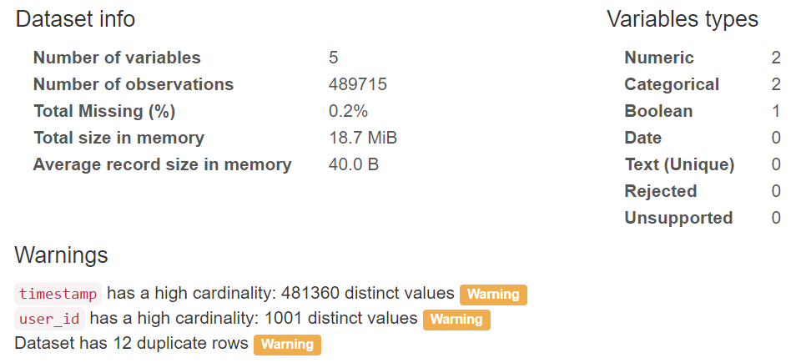
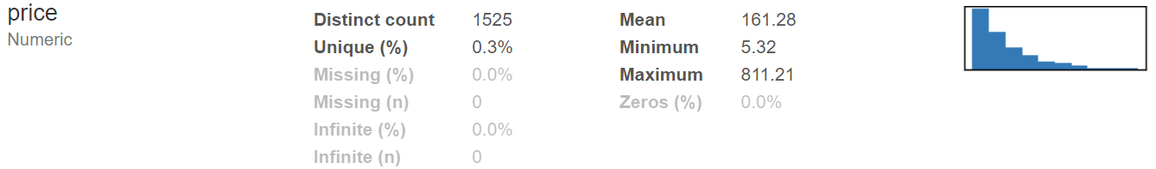
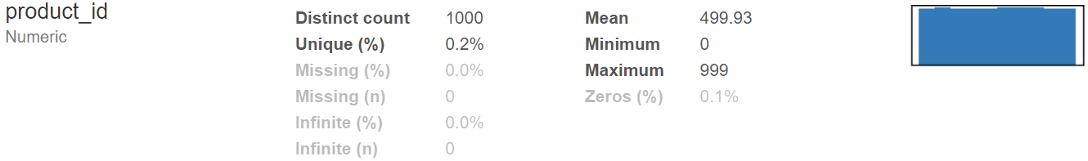
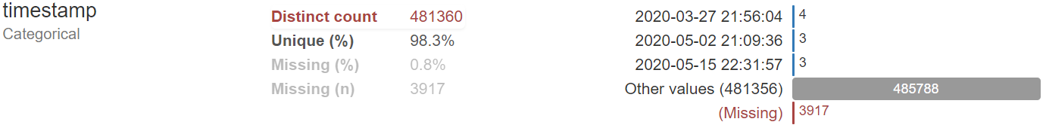
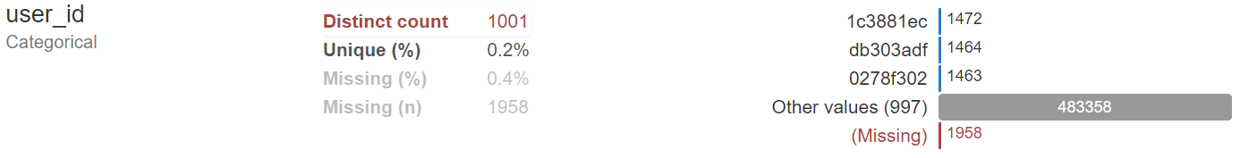
Data quality – Events
Overview
Variables

Slide 5
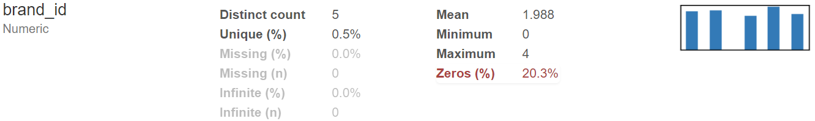
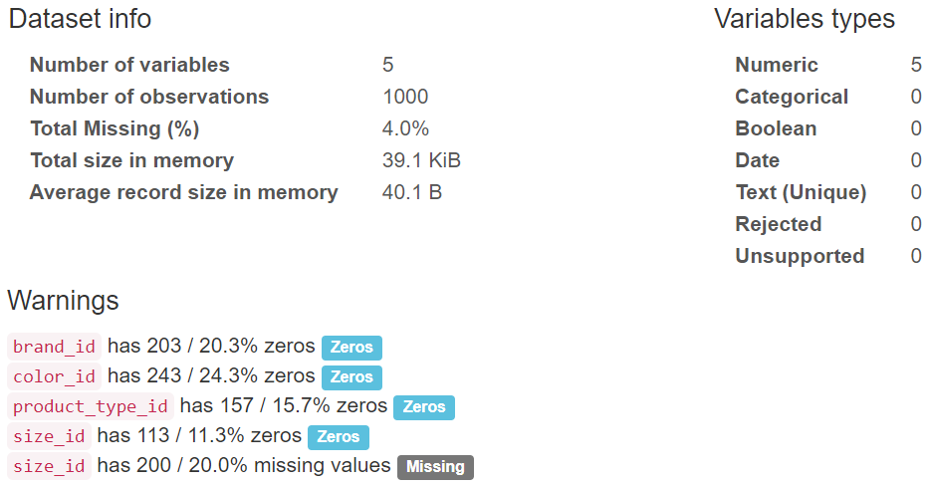
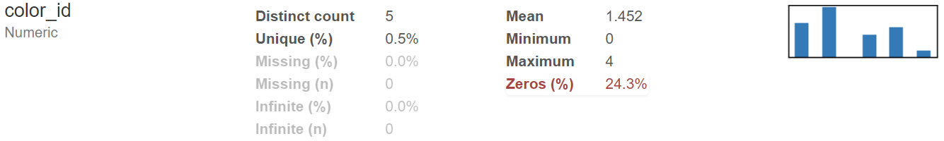
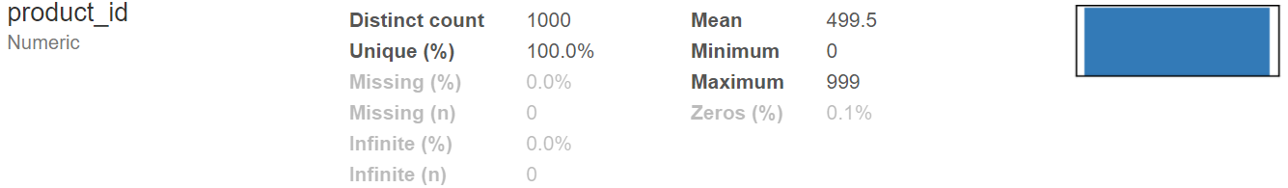
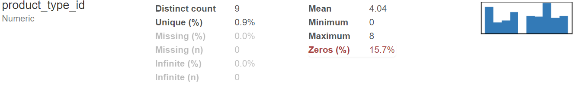
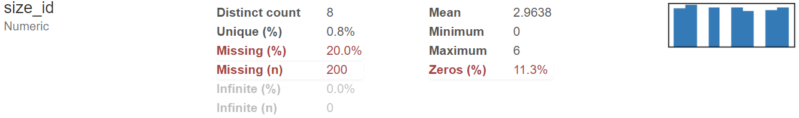
Data quality – products
Overview
Variables

Slide 6
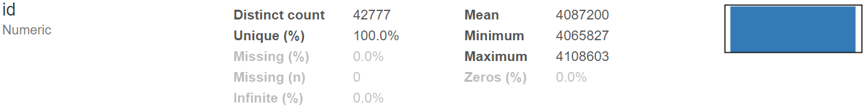
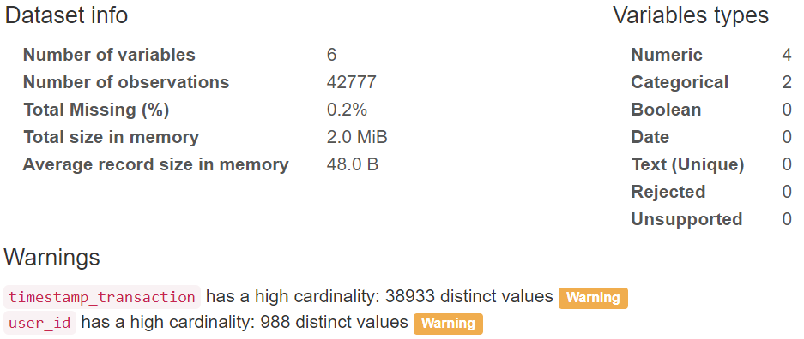
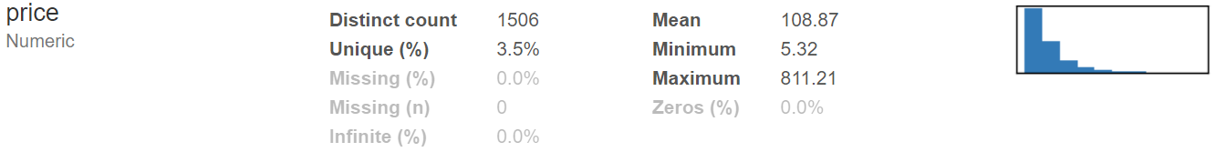
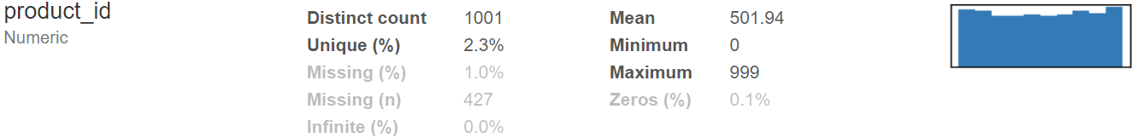
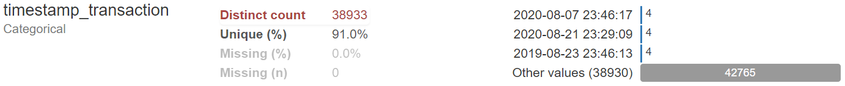
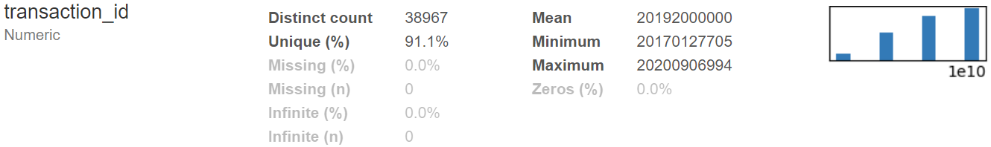
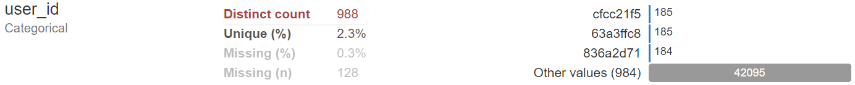
Data quality – transactions
Overview
Variables

Slide 7
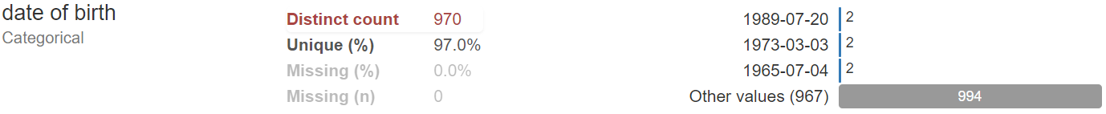
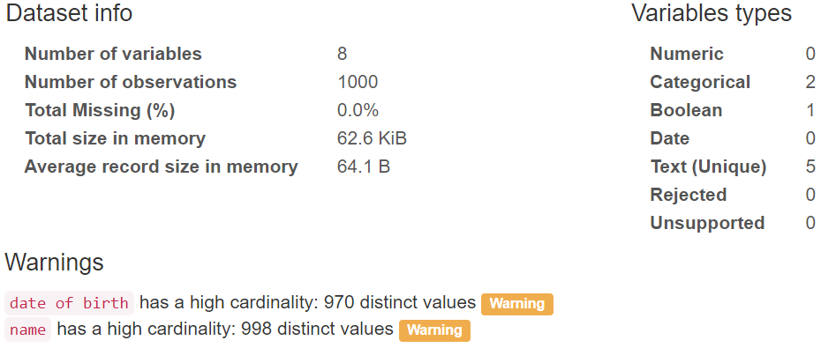
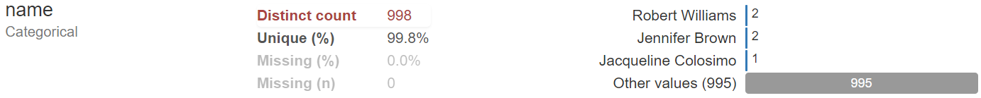





Data quality – users
Overview
Variables

Slide 8
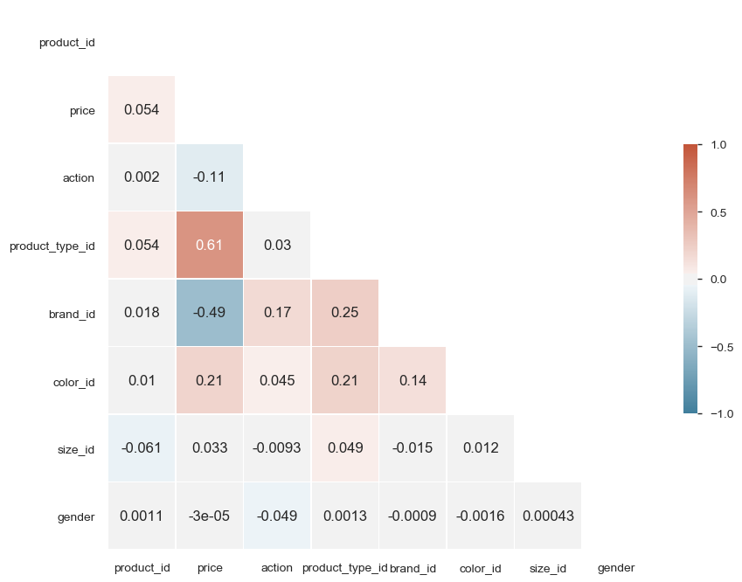
Feature relationships
Degrees of correlation
Perfect: ± 1
High degree: between ± 0.50 and ± 1
Moderate degree: between ± 0.30 and ± 0.49
Low degree: below ± 0.29
No correlation: 0
When analyzing the Pearson’s correlation between each event-product-user feature, we can observe the following:
A high degree of correlation between price and product type.
A strong negative correlation between price and brand.
A small correlation between the event action and the product’s brand and type.
A low degree correlation between the product’s color and its price, brand and type.

Slide 9
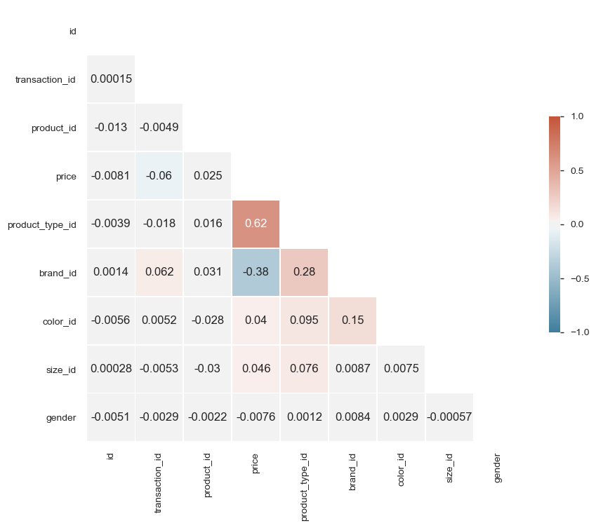
Feature relationships
Degrees of correlation
Perfect: ± 1
High degree: between ± 0.50 and ± 1
Moderate degree: between ± 0.30 and ± 0.49
Low degree: below ± 0.29
No correlation: 0
When analyzing the Pearson’s correlation between each transaction-product-user feature, we can observe the following:
A high degree of correlation between price and product type.
A strong negative correlation between price and brand.
A low degree correlation between the product’s brand and type.

Slide 10
Use cases
The three possible use cases that can be used to bring value to the company and its user base, using the available data are the following:
Forecast the amount of sales for the whole marketplace, providing an accurate projection of its business on a wide timeframe into the future.
Customer segmentation using clustering techniques. Analyze the user behavior using the available data and understand the recency, frequency and money value of each user group in order to optimize the conversion rate (subsequently increasing sales). Provide each user a set of suggested products based on its behavior.
Price optimization. Understand what is the best price for a product or group of products, when the price should change (sales, promotions, limited discounts) to increase sales and reduce cost.

Slide 11
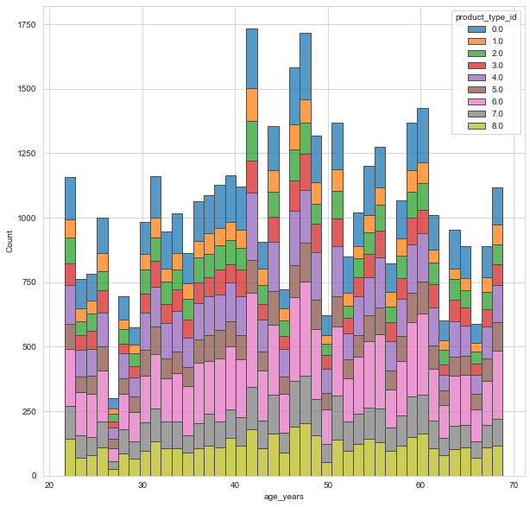
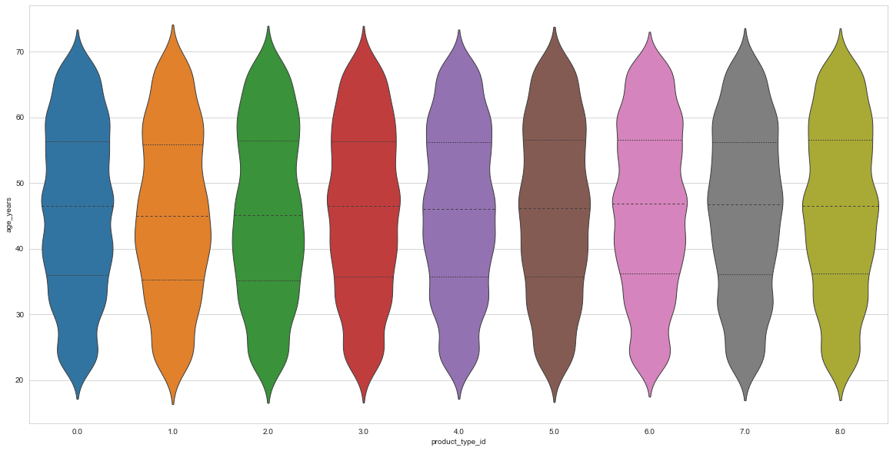
Product type by customer age
The analysis presents the number of products sold by age groups and product types. Even though the distribution of ages by product type is quite uniform, the median age for products 1 and 2 is slightly lower.

Slide 12
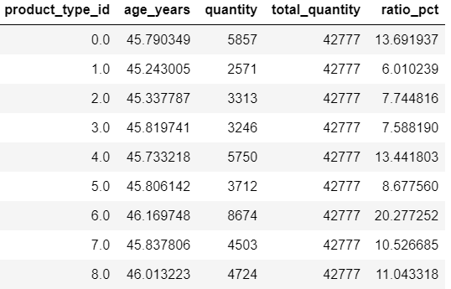
Product type by customer age
The table presents the average age by product type and the corresponding total quantity of products sold. The average age is quite uniform across product types. The percentage of products sold by type is shown in column ratio_pct.
As the violin plot previously indicated, the distribution of ages by product type is quite symmetric and uniform. Hence, we can assume that the probability that a product type from a given brand is sold depending on the age of the customer is based on the percentage of product sold multiplied by the percentage of scores in each quartile.

Slide 13
Daily Sales Prediction – MODEL PLANNING
In order to develop a model that predict sales amount for whole marketplace on a daily basis, there are a few important points to take into account beforehand:
As the amount of sales is a continuous measure, this can be assumed to be a time series forecasting regression problem.
The regression loss function to use should be either the Mean Squared Error or the Mean Absolute Error, according to the problem’s nature. It should be noted that if the data is too corrupted with outliers, than the MAE is the more robust solution.
The steps to solve this problem would be the following:
Data preparation (e.g. handling missing values, encoding categorical values)
Feature selection.
Split the data into train and test sets (taking into account the date order).
Split the train set into cross validation sets (taking into account the date order).
Implement a pipeline to scale the cross validation sets, train the model and perform the hyperparameter tuning. Evaluate each model and get the parameters with lowest error.
Use the best parameters and predict using all training data. Evaluate the model.
Test the model with the test set that was held out in step 3.

Slide 14
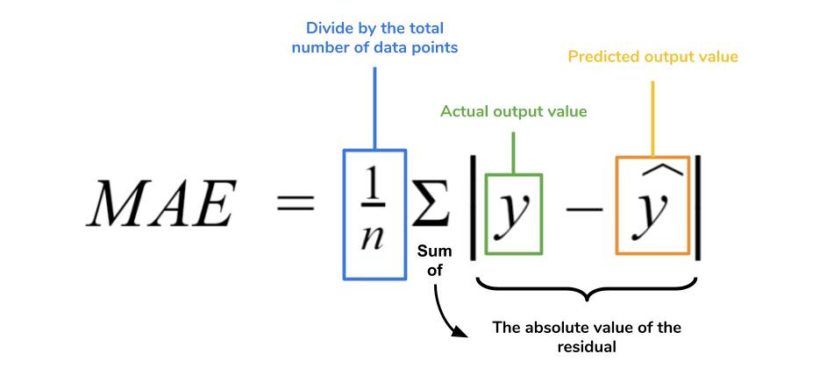
Weekly Sales Prediction – MODEL DEVELOPMENT
Using the given dataset to develop a prediction model and predict the weekly sales for a certain brand, there were a few assumptions considered:
The data was initially split into train and test sets (taking into account the date order), then the train set into cross validation sets.
The model performance was evaluated using the Mean Absolute Error, using the train and test sets.

Slide 15
Weekly Sales Prediction – MODEL Improvement
There are a few possibilities to improve the model performance:
Include more lags as model inputs, feeding the model with more historical data and increasing its complexity.
Include other relevant features into the model, such as transaction volumes.
Feed external data into the model, such as information about the economy (e.g. GDP) or about the date itself (e.g. holidays and weekends).

Slide 16
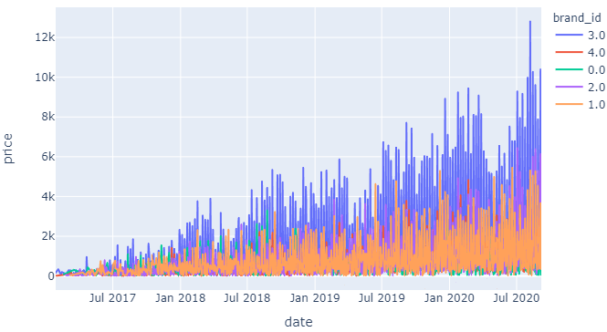
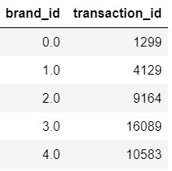
Sales performance by brand
The graph presents the evolution of the total amount of sales (price) by brand throughout time. The table below show the number of transactions by brand. When comparing the sales performance of each brand, we can conclude the following:
Brand 0 has poor sales performance.
The poor sales performance of brand 0 is not related to the price of its products, but to the number of transactions made.
Therefore, in order to increase sales in the future, it should be put in place an action plan to increase the transaction volume of brand 0 products with:
Special discounts and offers for that brand.
Higher visibility of brand 0 products on website.

Slide 17
Price optimization
In order to determine the best price of a certain product for each season of the year, there are a few important points to take into account beforehand:
As the price is a continuous measure, this can be assumed to be a time series forecasting regression problem.
The steps to solve this problem would be the following:
Data preparation (e.g. handling missing values, encoding categorical values)
Feature selection.
Split the data into train and test sets (taking into account the date order).
Split the train set into cross validation sets (taking into account the date order).
Implement a pipeline to scale the cross validation sets, train the model and perform the hyperparameter tuning. Evaluate each model and get the parameters with lowest error.
Use the best parameters and predict using all training data. Evaluate the model.
Test the model with the test set that was held out in step 3.
In case the back-end team needs to use the latest model output in Production, through a Restful API, the output format would be JSON.

